Slide 1


Slide 2
AGENDA
Brainstorming
Organization
Demonstration
Implementation
Testing
Grading
Q&A

Slide 3

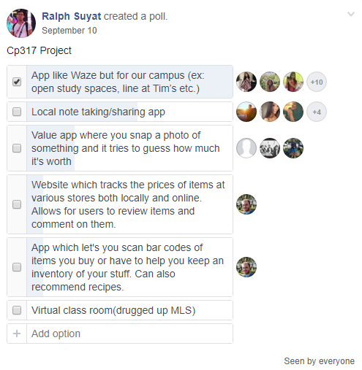
BRAINSTORMING

Slide 4
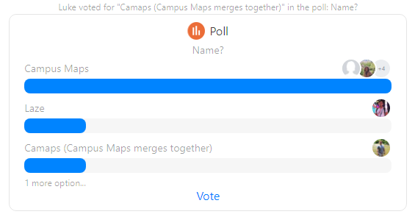
APP NAME

Slide 5
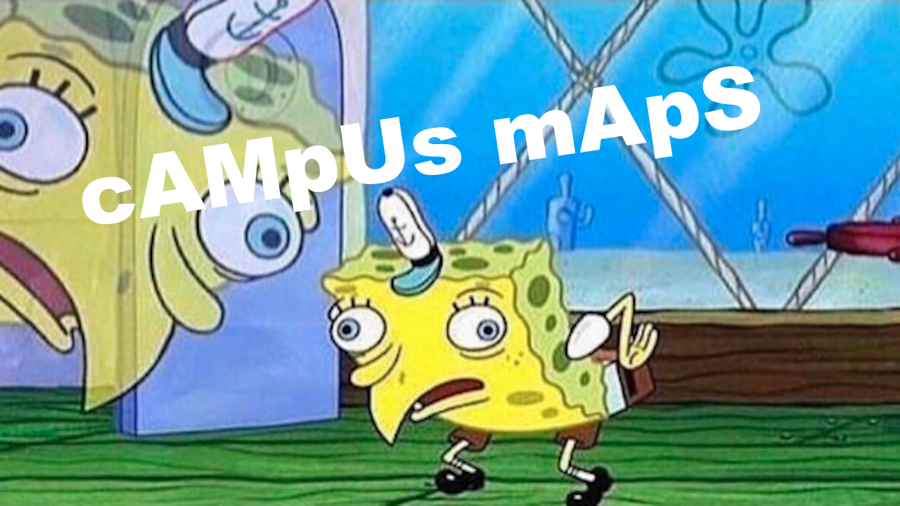

Slide 6



Slide 7
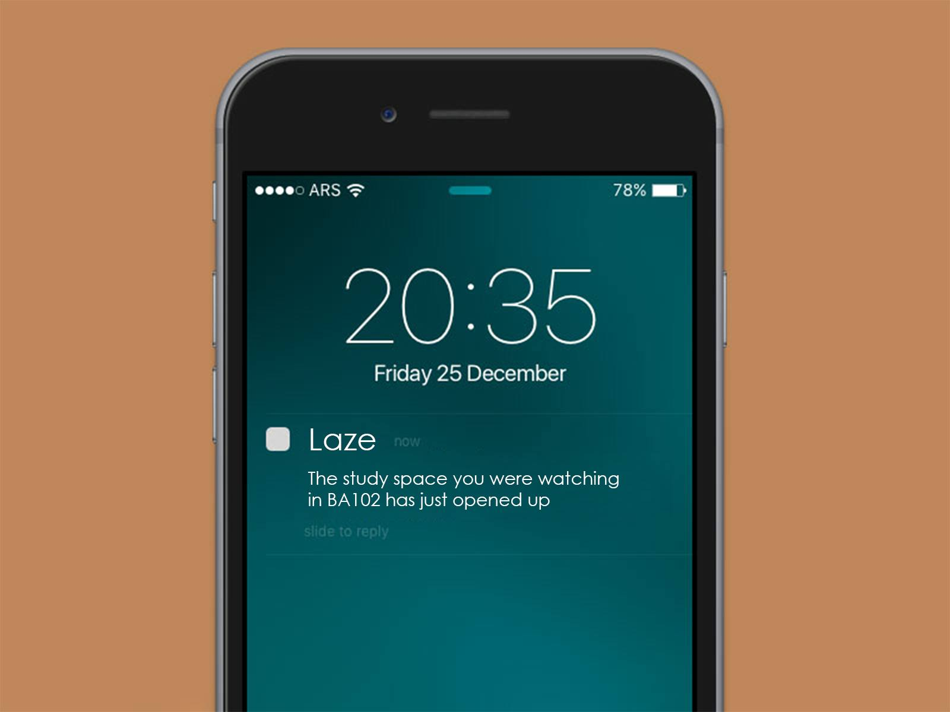
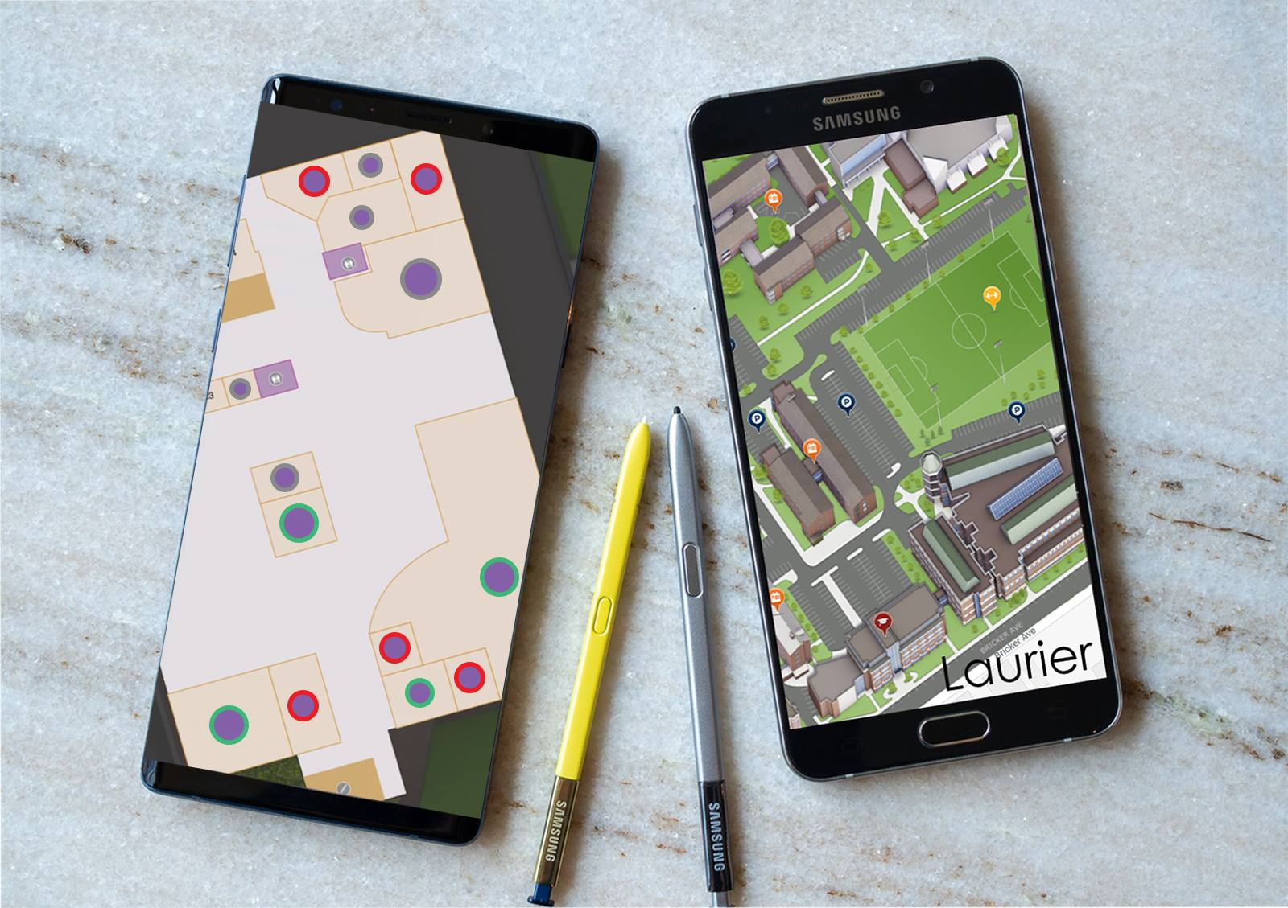
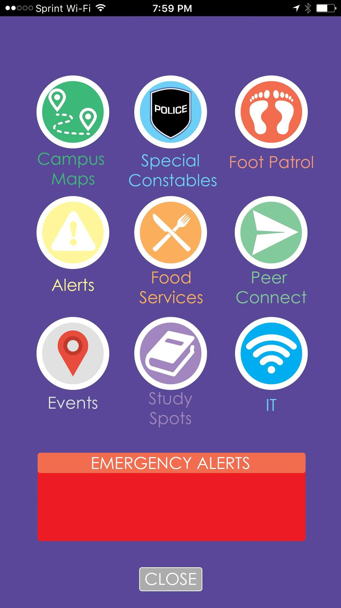

GRAPHICS

Slide 8
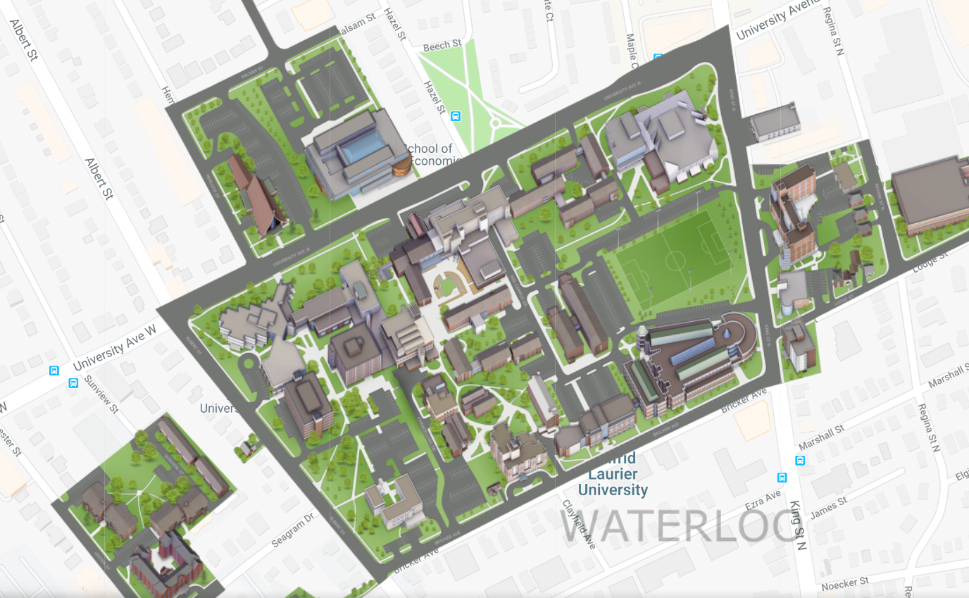
SAMPLE PROTOTYPE

Slide 9
ORGANIZATION
What type of organizational structure did Laze use?
Synchronize-and-Stabilize / Democratic
What? We split into sub-groups to accomplish different tasks, and natural leaders were important to keep the teams on track.
Why? Members could play to their strengths to maximize everyone’s productivity.
What would we change? More emphasis on giving designated roles of leadership to individuals even earlier than we did allowing them to assign specific tasks to members early.
Notes:
Mansi to talk on this

Slide 10
DEMONSTRATION
Multiple User types (normal users, admin user)
User Registration
Password Reset
Login page
All data is editable through the Admin Page
Works on Mobile

Slide 11
DEMONSTRATION
Draggable & Zoomable Map
Placeable Pins
Pins can only be placed on campus
Deletable Pins
Pins are only deletable by the user who created the pin and admin users
Pins are easy to spot, click, and use to view information
Pins are searchable

Slide 12






IMPLEMENTATION

Slide 13
IMPLEMENTATION - Django
Fast
Convenient
Has many built in capabilities
Built-in admin panel
Email service
Database
Users & Login
Form validation
Page Templating
Uses python, a familiar language

Slide 14
IMPLEMENTATION - Bootstrap & JQuery
Both are widely used Javascript libraries
Helps with consistent styling throughout the site
Faster development than vanilla JS
Simplifies HTML and CSS manipulation

Slide 15
IMPLEMENTATION - Google Maps Javascript API
Used for the map interface
Allowed for easily placed and selected pins
Supplied a familiar and responsive interface
Allowed us to customize the map according to our needs
Flexible and easy to work with API

Slide 16

IMPLEMENTATION - Virtual Environment
Used to keep project packages separate from other system packages

Slide 17
IMPLEMENTATION - Python and Packages
Allowed us to use Django
Familiar Language
Syntactic Sugar speeds development
Used Coverage package for testing

Slide 18
IMPLEMENTATION - Github
Was required for this course
Tracked work done by team members
Version-control system
Helps coordinate group development
Allows work to be done offline while maintaining consistency overall
Our Repository:
https://github.com/lauriercp317/laze

Slide 19
TESTING
What kinds of testing did Laze do?
Functional Testing
Automated Unit Tests
e.g. only authenticated users may login/pin/other features
Utilization of Coverage (Python package) which shows code coverage testing for Python
Integration Testing
Map Pin Testing
e.g. Ensure page redirects to proper destinations
Manual placement of pins while under different users (as ,admin, user, guest)
Non Functional Testing
e.g. security, performance etc
User Acceptance Testing
e.g. the end user
Notes:
Mansi to speak

Slide 20
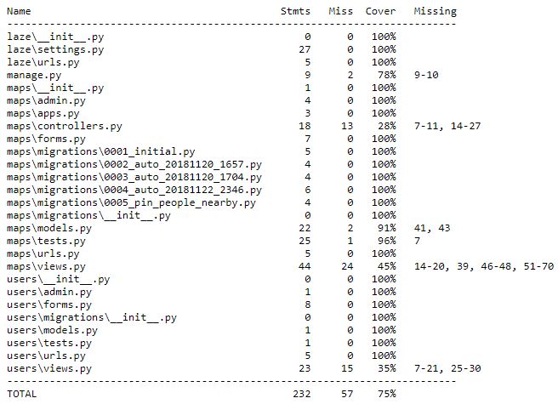
AUTOMATED TESTING SNAPSHOT
Coverage.py
Shows what files have been covered, and which lines have been missed

Slide 21
GRADING
Met forecasted deadlines
Have a working product functioning as intended
A
Delivers original value proposition of what we envisioned Laze to be
David Brown is awesome. Pizza.

Slide 22
Q&A
Thank You!

